Slide 1

BY :- RAGINI PARATE
Assistant Professor Commerce, and Selected Post - Assist. Grade 3 , Teacher, Accountant , Divisional Accountant Field Assistant , Pre bed Top 7 Rank , B.COM and M.COM Gold Medalist

Slide 2
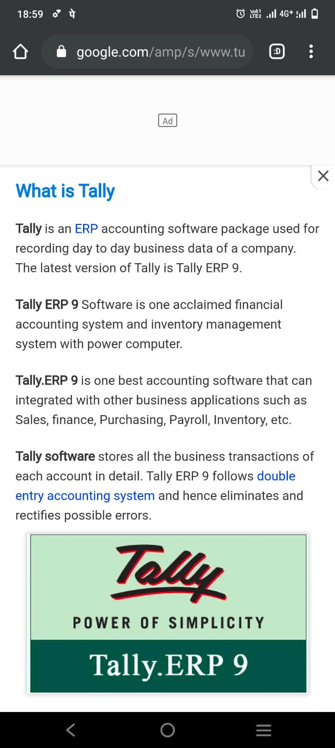

Slide 4
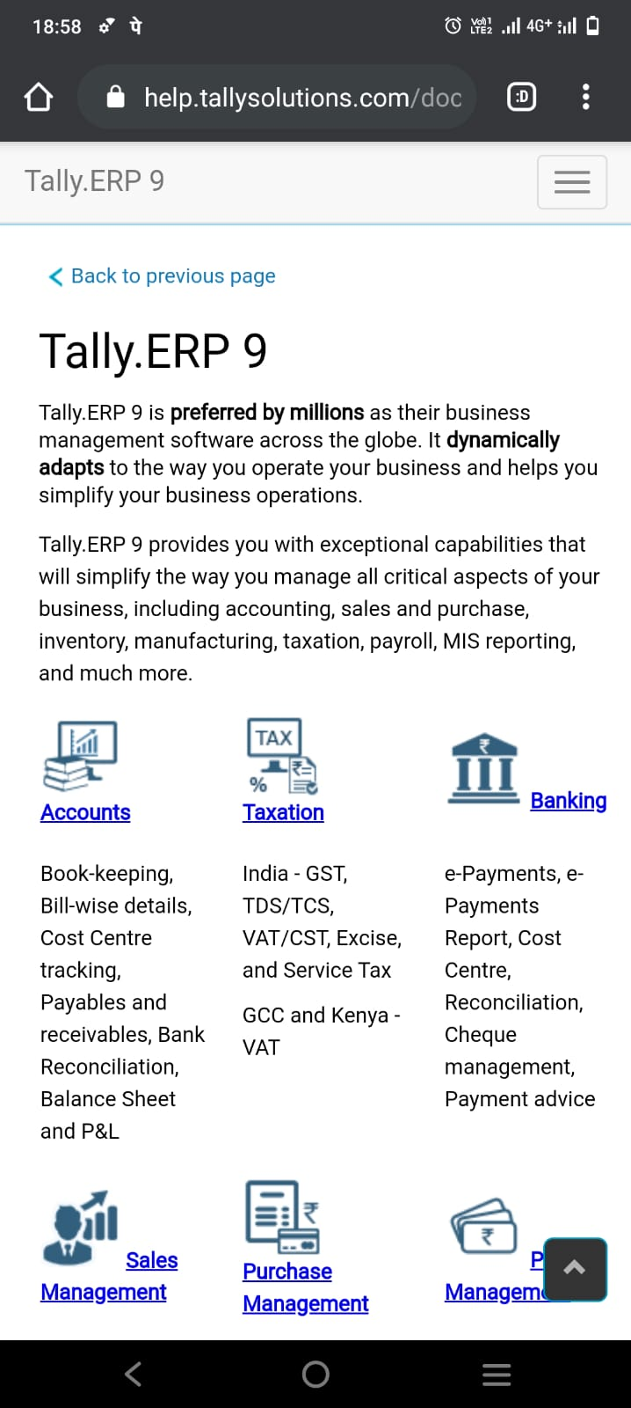

Slide 5
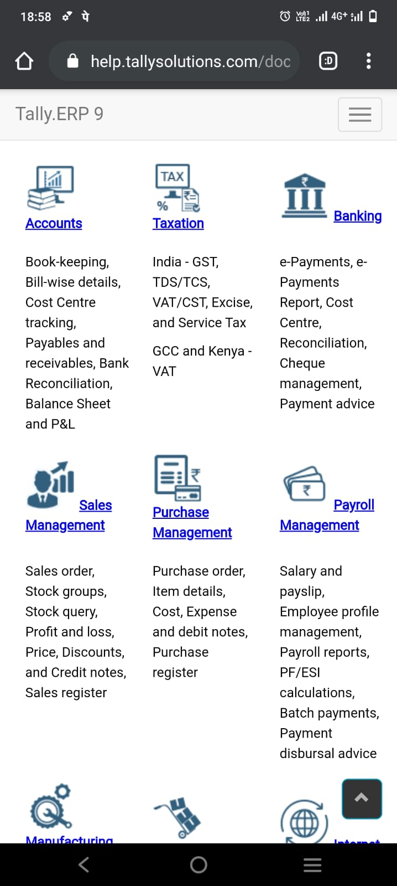

Slide 6
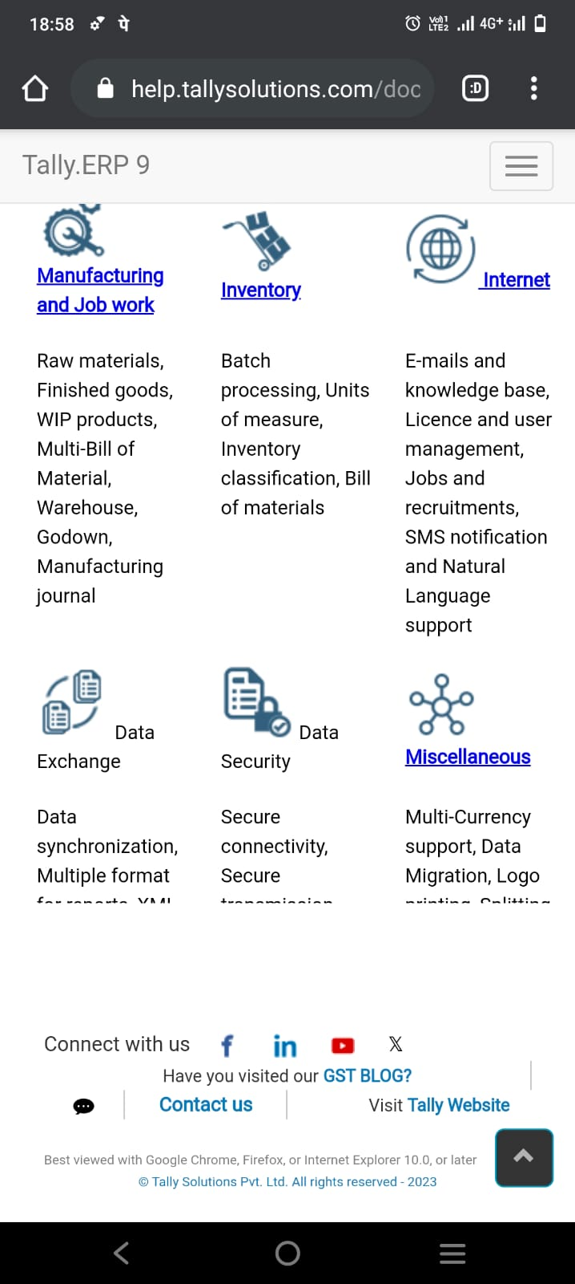

Slide 7

Features of Tally

Slide 8
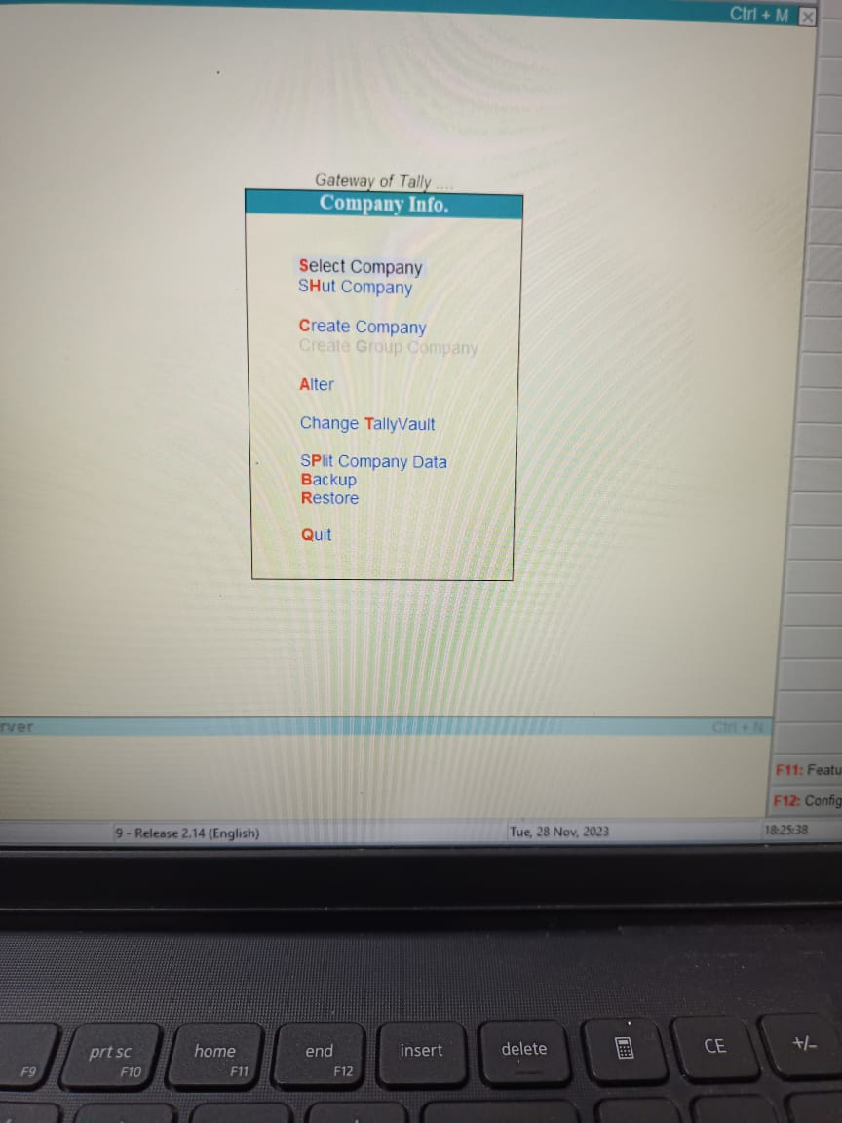
How to Create Company

Slide 9
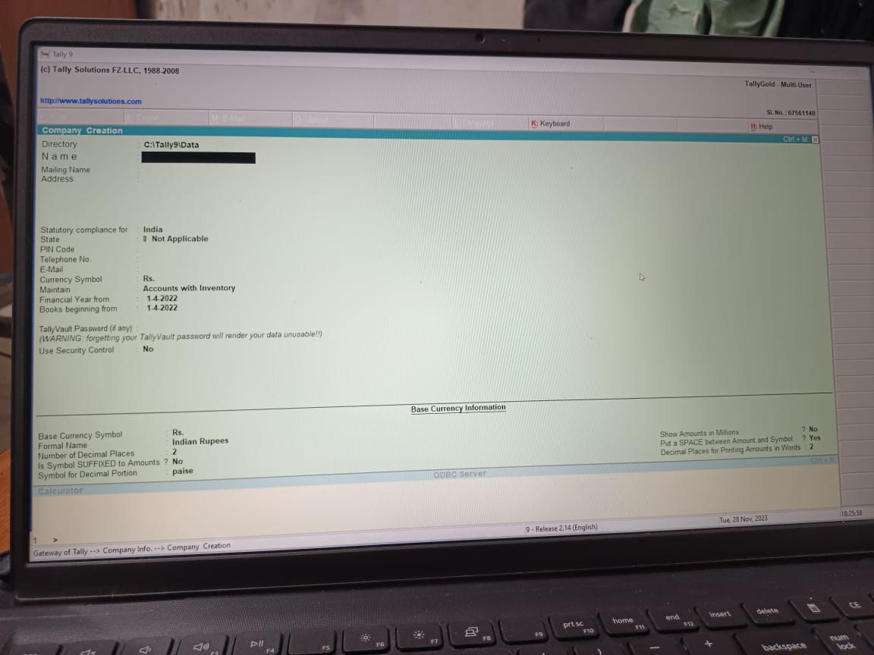

Slide 10
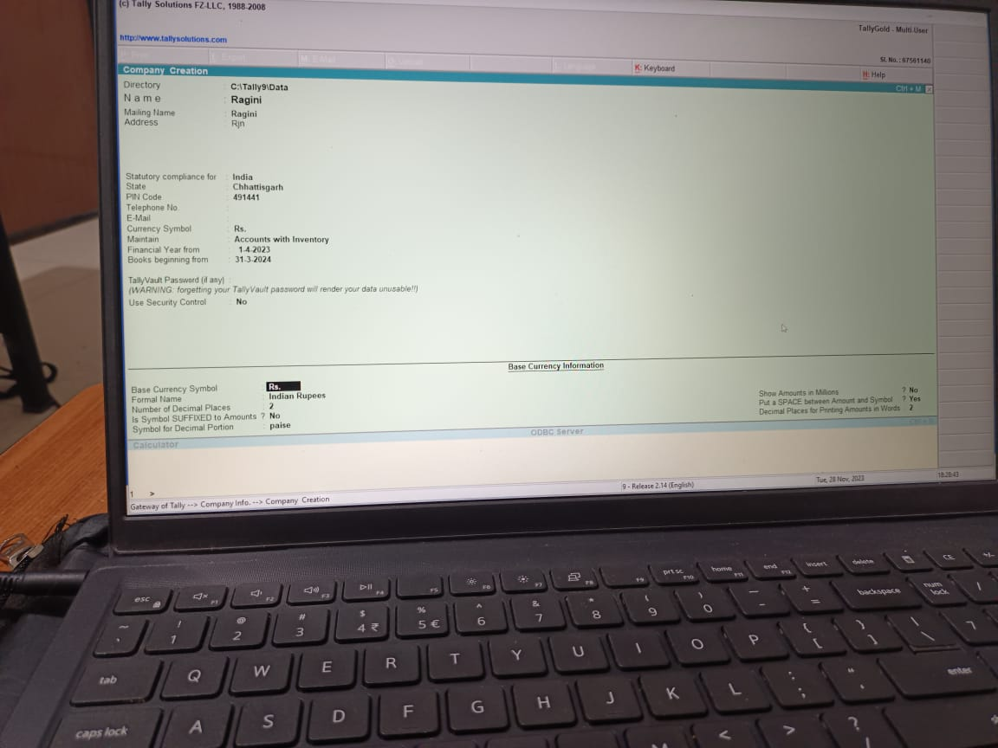

Slide 11
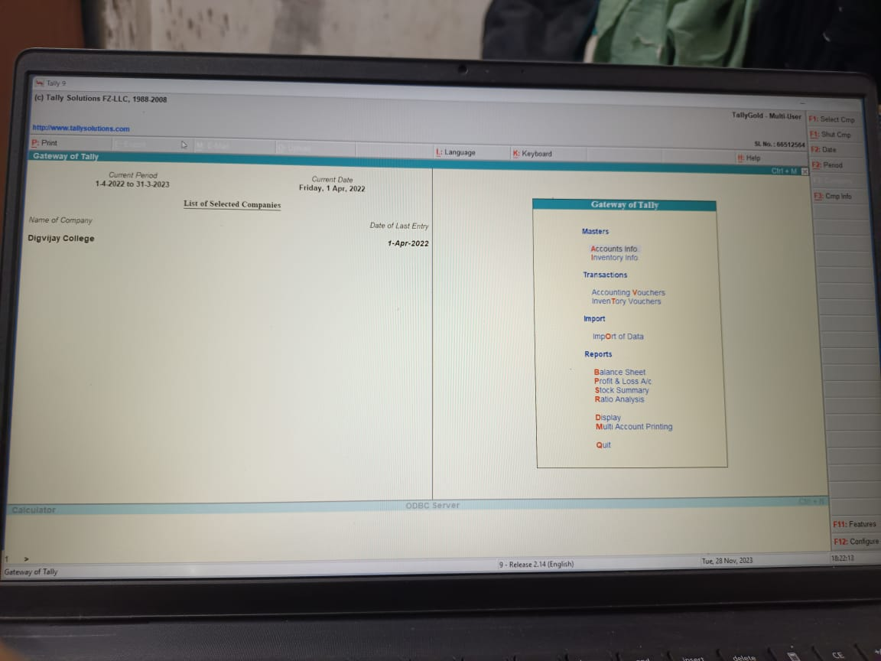
How to Transaction Entry in Tally Software

Slide 12
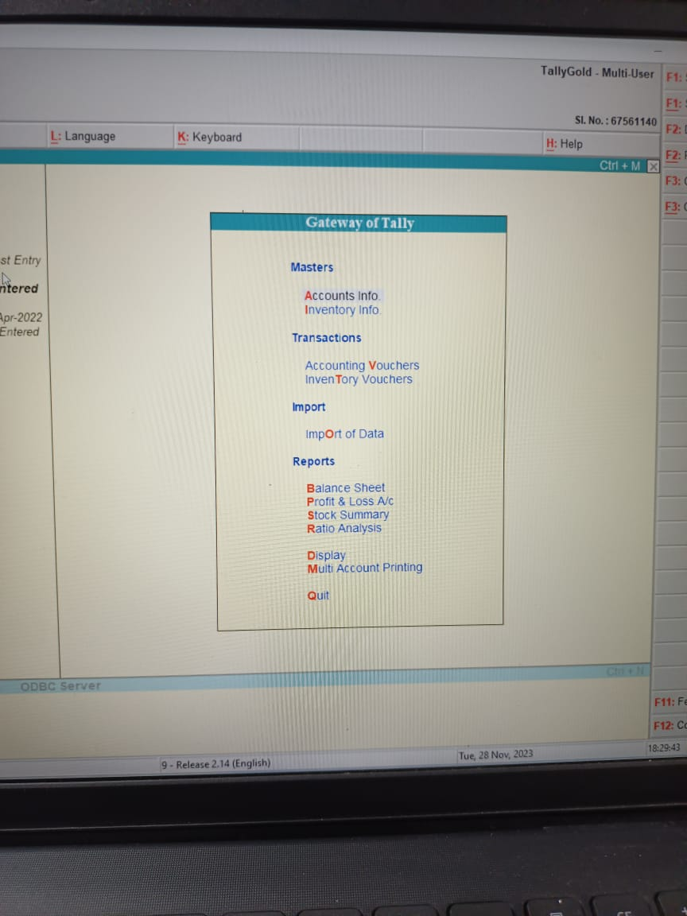
Tally interface

Slide 13
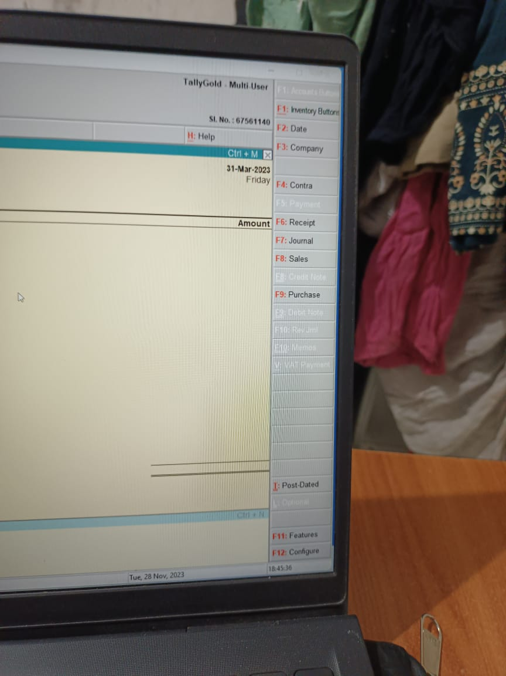
Shortcut Keys :-

Slide 14
Let ,s Start Tally ERP. 9 Practical

Slide 15
THANK YOU

