Slide 1
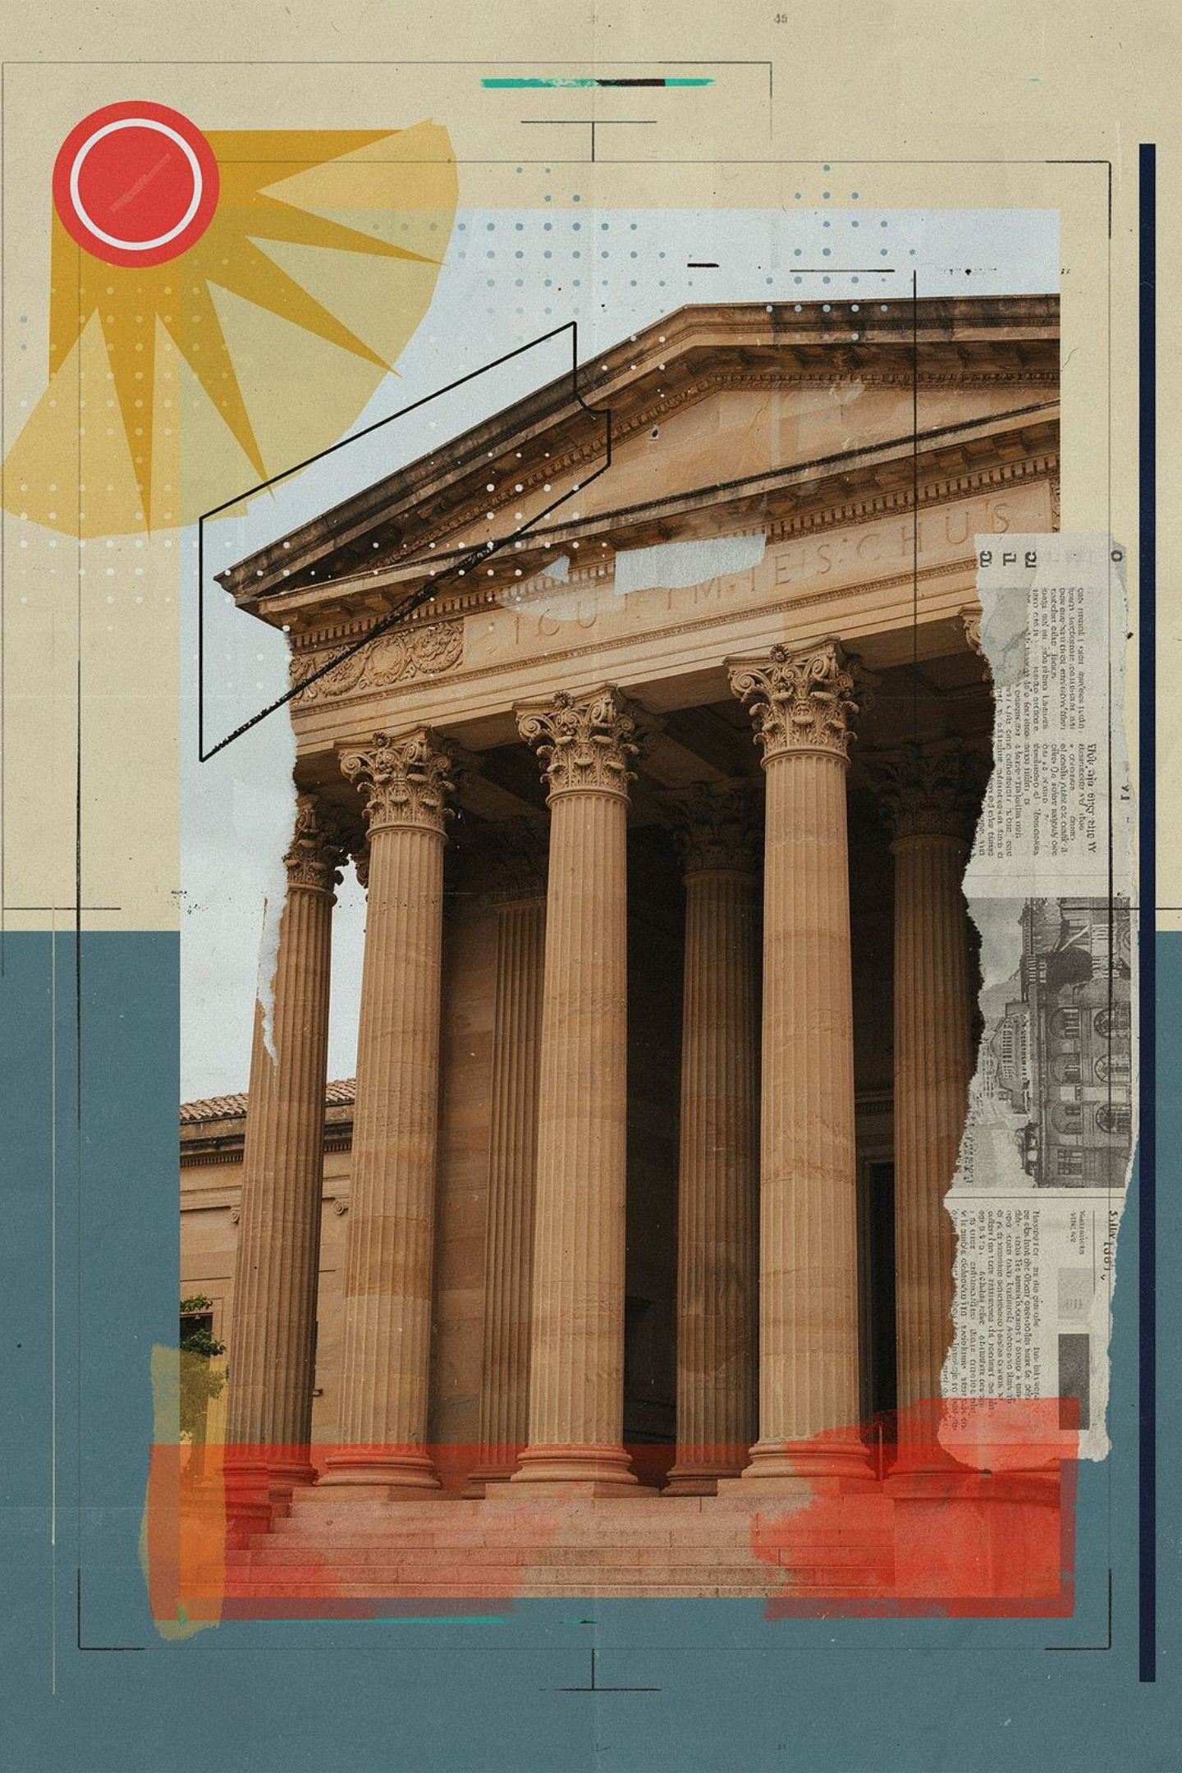
Parliamentary vs Presidential Systems: A Global Comparison
How the structure of government shapes the fate of nations — a deep dive into the world's two dominant models of democratic governance.

Slide 2
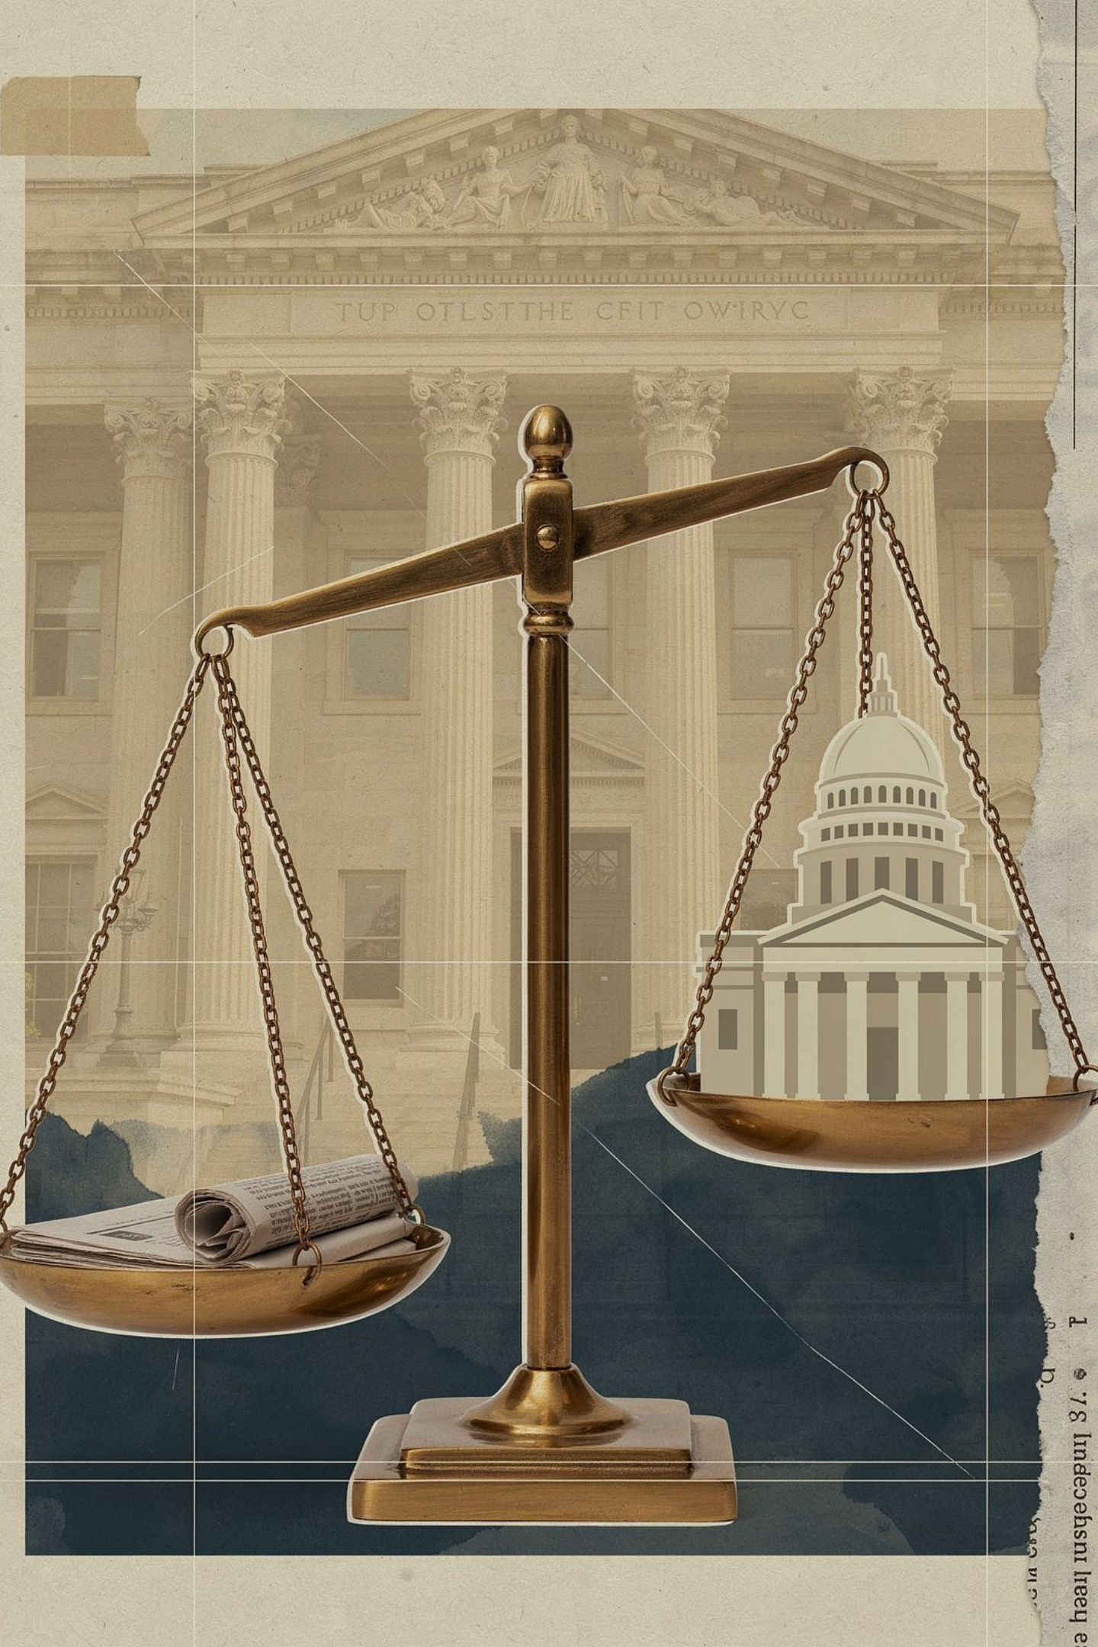
Defining the Foundations
Executive Power
Legislative Relationship
Who holds the mandate to govern — elected directly by the people or drawn from the legislature?
Fusion of powers in parliamentary systems vs. strict separation in presidential models.
Governance Goals
Every system must balance stability, democratic accountability, and broad political representation.

Slide 3
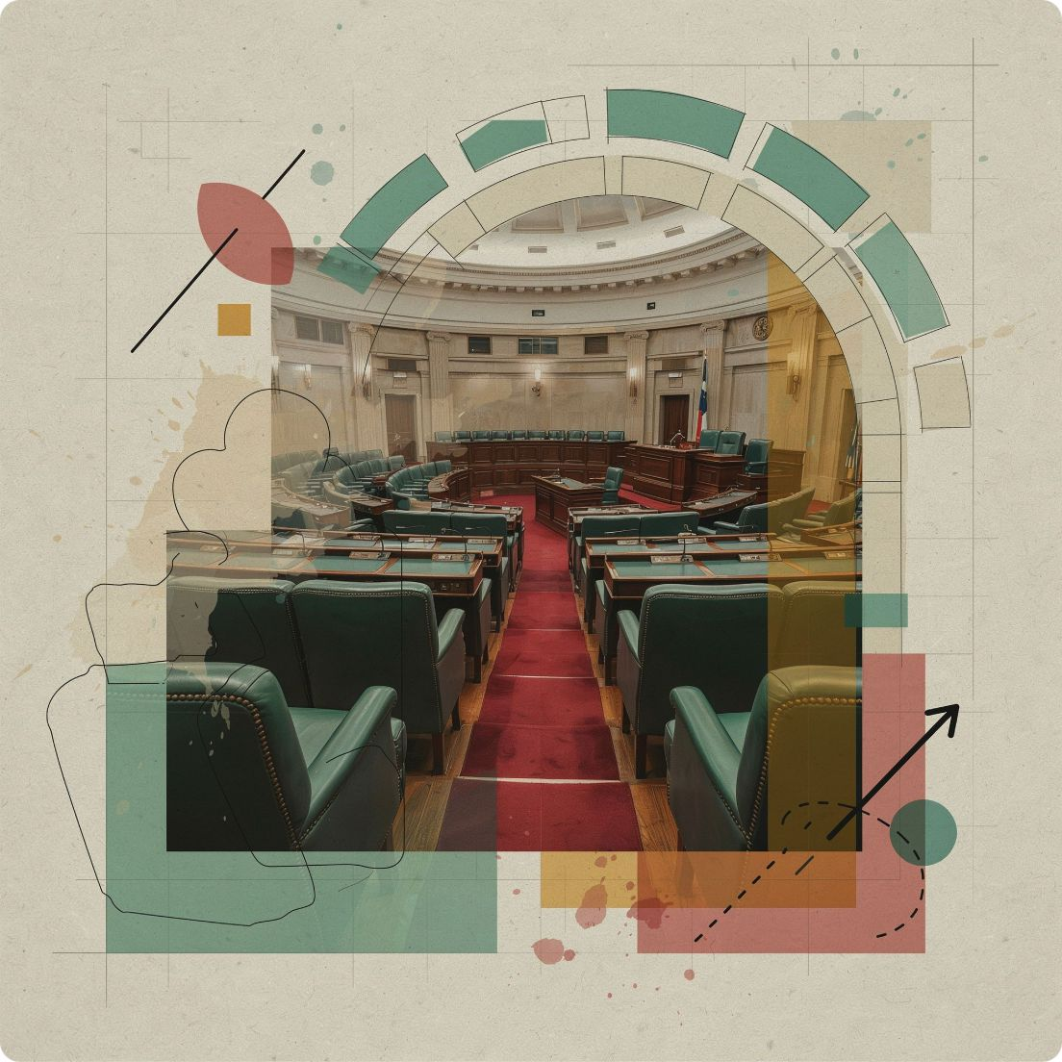
CHAPTER 1
The Parliamentary Architecture
Core Concept
The executive branch is selected from within the legislature, creating an intrinsic bond between the two branches of government.
Mutual Dependence
Government can only function as long as it retains the confidence of the legislative majority — a continuous democratic test.
Accountability
Oversight is embedded through question time, committee scrutiny, and the ultimate weapon: votes of no confidence.

Slide 4

The Prime Minister: Real vs Formal Power
Prime Minister — Active Executive
Head of State — Ceremonial Role
Why It Works
Strong party discipline ensures policy flows efficiently from election manifesto to enacted law, with minimal institutional friction.
The PM is the true engine of government: setting legislative agenda, commanding cabinet, and directing national policy with party backing.
Monarchs or presidents in parliamentary systems serve as symbolic figureheads — embodying national identity without wielding executive authority.

Slide 5
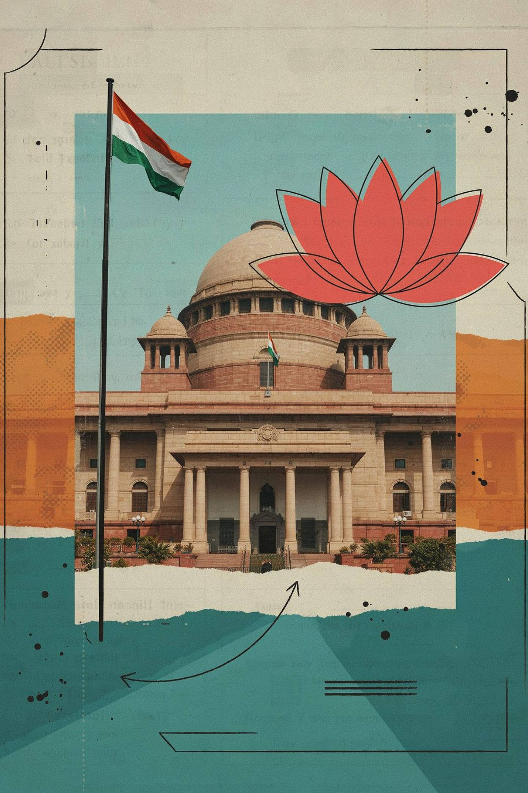
Parliamentary Case Study: The Indian Model
1
Colonial Roots
Legislative reforms under the Acts of 1919 and 1935 laid the groundwork for representative governance.
2
Strategic Choice at Independence
A parliamentary model was chosen to accommodate India's vast social, linguistic, and regional diversity.
3
Dual Executive Structure
Political ministers provide direction; a permanent civil service ensures continuity and institutional memory.

Slide 6
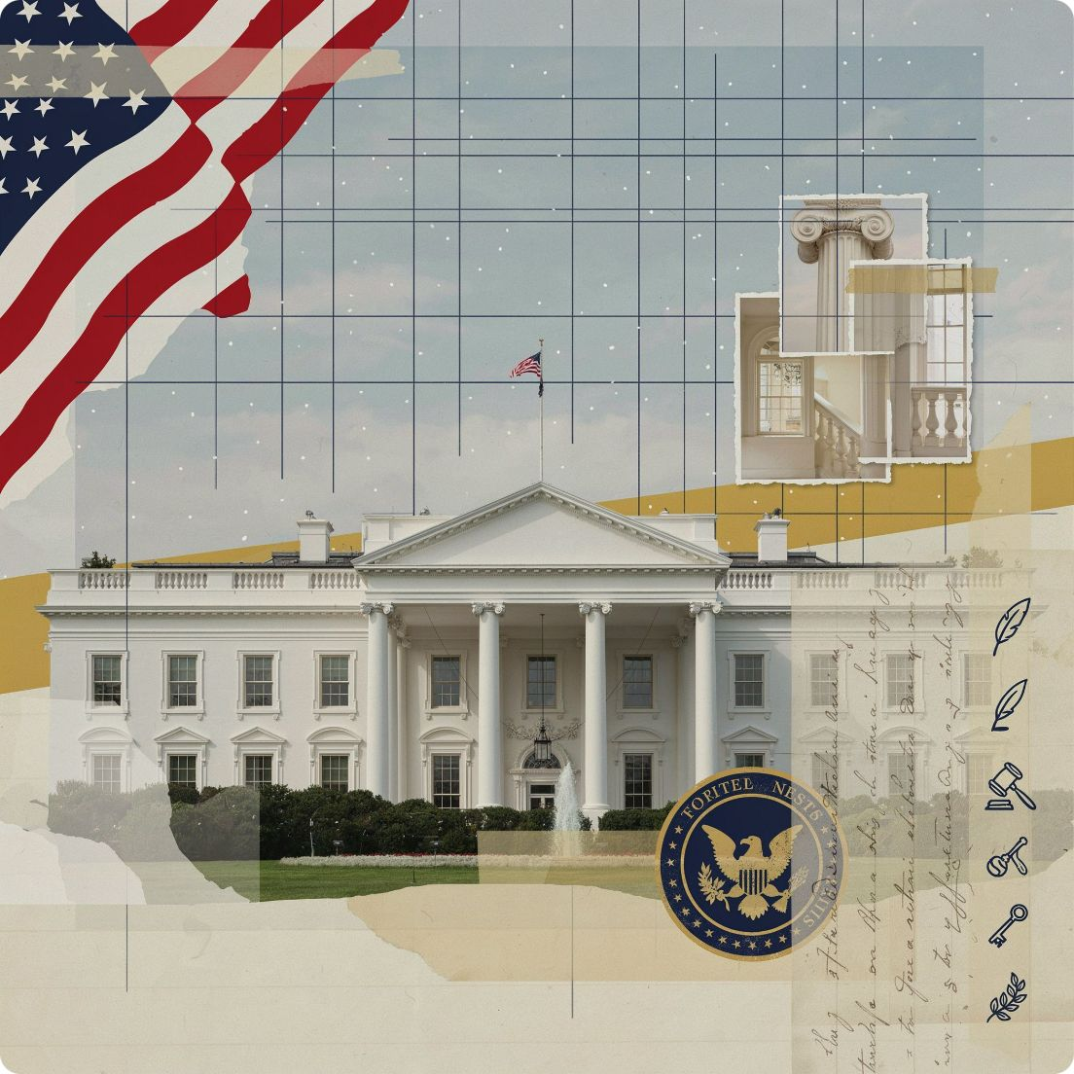
CHAPTER 2
The Presidential Alternative
Independent Selection
The executive and legislature are elected separately by the people, each carrying its own mandate — neither branch depends on the other for its survival.
Single Executive Authority
The President functions as both Head of State and Head of Government, concentrating executive power within a single elected office.
Fixed Terms
Guaranteed tenure delivers policy stability but risks political gridlock when the president and legislature belong to opposing parties.

Slide 7



The Power of the Presidency
Popular Mandate
Institutional Independence
Checks & Balances
Direct election grants the president a powerful national legitimacy that no parliamentary executive can fully replicate.
The president operates free from the legislative agenda, enabling long-term planning without constant parliamentary approval.
Veto powers, treaty ratification authority, and key appointments create a robust system that constrains unchecked power.

Slide 8
Comparative Snapshot
Feature | Parliamentary | Presidential
Executive Head | Dual: PM + Ceremonial Head of State | Single: President holds both roles
Tenure | Uncertain — subject to no-confidence vote | Fixed constitutional term
Cabinet Members | Must be elected members of parliament | Appointed independently, not legislators
Executive Source | Drawn from legislative majority | Separately and directly elected
Accountability | Continuous parliamentary scrutiny | Periodic electoral accountability

Slide 9
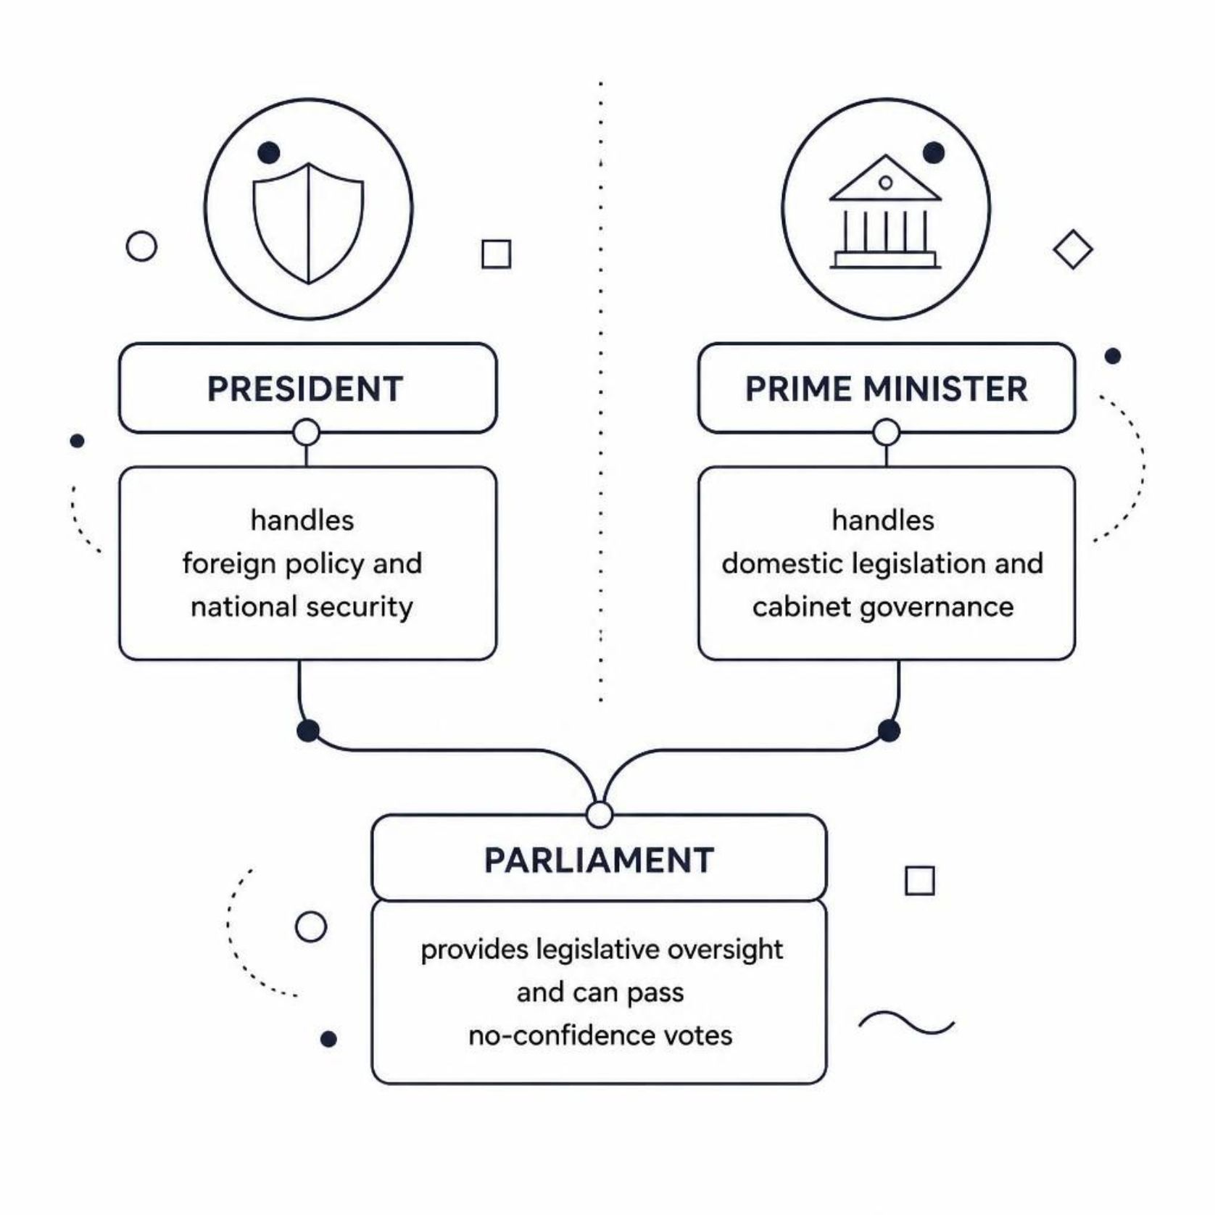
CHAPTER 3
The Hybrid Dynamics
The Semi-Presidential Reality
Countries like France and Russia blend both models — a directly elected president shares executive authority with a prime minister accountable to parliament.
Competing Authority
When the president and PM come from opposing parties, "cohabitation" creates tension, negotiation, and occasional paralysis.
Global Adaptability
Emerging democracies often choose hybrid models to balance strong leadership with parliamentary checks, tailoring structures to local political culture.

Slide 10
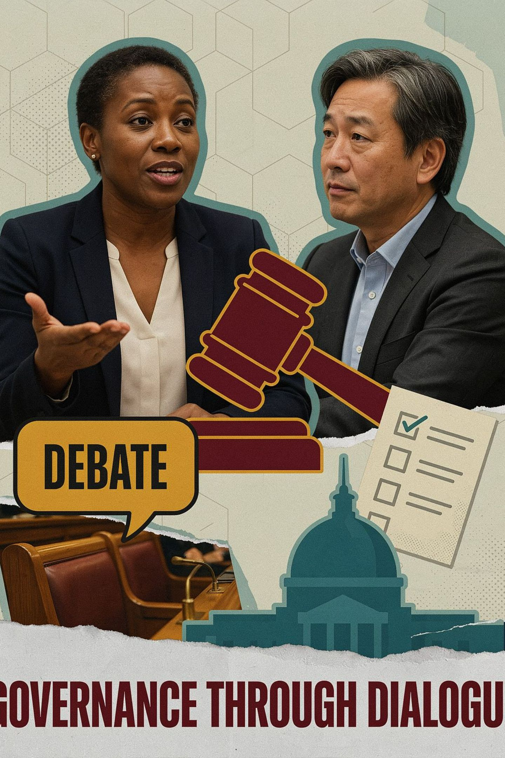
The Case for Parliamentary Stability
Flexibility in Leadership
Underperforming leaders can be replaced swiftly through votes of no confidence — the system self-corrects without waiting for an election cycle.
Cohesive Governance
Party-led executive ensures the government and its legislative majority share aligned goals, accelerating policy from debate to law.
Citizen Responsiveness
A continuous link between the electorate, elected MPs, and the cabinet keeps governance anchored to public sentiment and changing needs.

Slide 11



The Case for Presidential Strength
Stability Through Fixed Terms
Singular National Mandate
Institutional Integrity
A directly elected president embodies a unified national vision — transcending party factions to represent all citizens with a clear policy direction.
A strict separation of powers prevents any one branch from dominating — the legislature, executive, and judiciary operate as genuine co-equals.
Guaranteed tenure removes constant political maneuvering, enabling leaders to pursue long-term national strategies without fear of sudden removal.

Slide 12
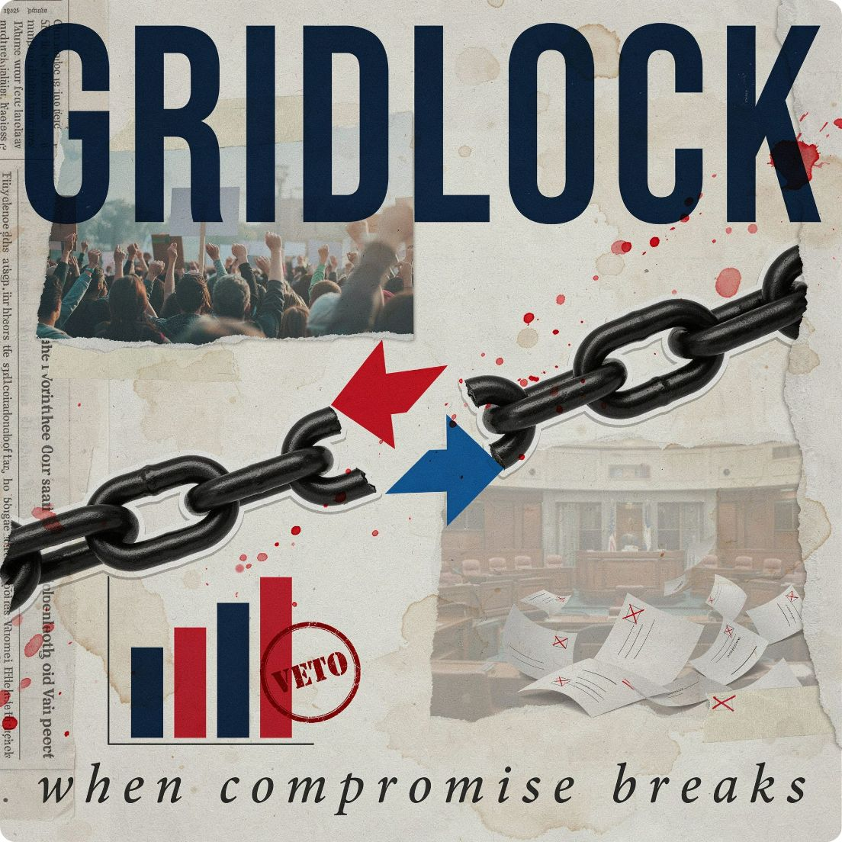
The Hidden Costs of Presidentialism
⚠ Deadlock Risk
⚠ Rigid Tenure
⚠ Winner-Takes-All
Fixed terms can trap a nation with deeply unpopular leadership, with no constitutional mechanism for early removal short of impeachment.
When the executive and legislature are controlled by opposing parties, governance can grind to a halt — budgets stall, reforms fail.
The concentration of power in a single office can breed perceptions of autocracy and marginalise minority political voices entirely.

Slide 13
Evaluating Global Performance
01
02
03
Consensus vs Majoritarian
Role of Interest Groups
Context-Dependent Outcomes
Proportional electoral systems tend to favour parliamentary models; first-past-the-post systems may align better with presidential structures.
Parliamentary caucuses and organised interest groups shape policy differently in each system — coalition negotiations vs. executive lobbying.
No single system outperforms universally. Culture, history, institutional trust, and civil society strength all determine which model delivers better governance.

Slide 14
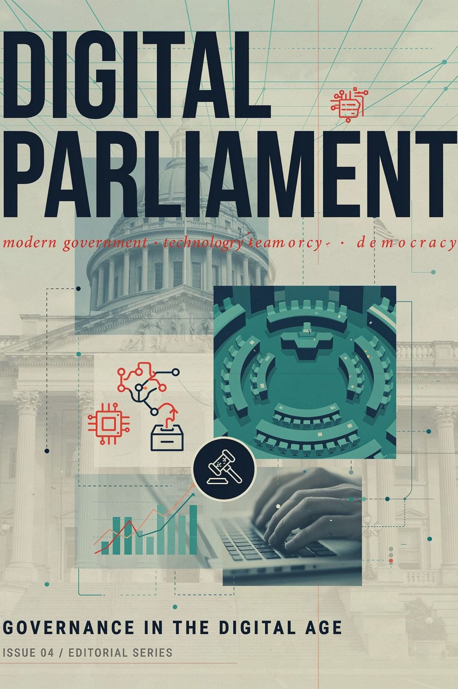


Modern Governance Challenges
Divided Government
Rising Party Influence
When the executive and legislature are at odds, critical legislation on climate, healthcare, and economic reform can be delayed for years, deepening public cynicism.
Increasingly disciplined party machinery constrains individual legislators — both systems face the tension between party loyalty and independent representation.
The Evolving Head of State
In the 21st century, even ceremonial heads of state wield soft power — as moral authorities, crisis communicators, and symbols of national unity during turmoil.

Slide 15

Conclusion: The Future of Democracy
No Perfect System
The Path Forward
Final Takeaway
Every model involves trade-offs between efficiency, representation, and oversight. The ideal system is the one best suited to a nation's unique social fabric.
Democracies must remain willing to adapt — incorporating constitutional reforms, hybrid mechanisms, and civic innovations that reflect evolving aspirations.
The choice of governance structure is not merely academic — it fundamentally determines the quality, responsiveness, and legitimacy of national leadership.
System design shapes national destiny — choose deliberately, govern responsibly.

